Slide 1
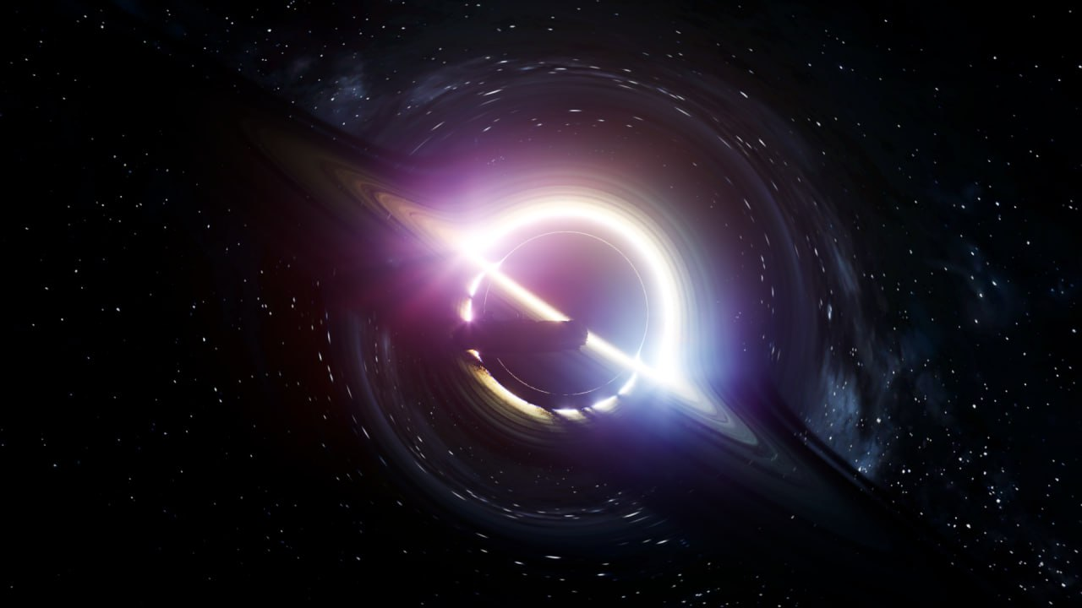
OBLIVION
Creative Installation
Interactive Black Hole Visualization
Artistic Sonorization
Group Members
Riccardo Di Bella
Marco Muraro
Stefano Ravasi
Music and Acoustic
Engineering
A.Y. 2023-2024
Creative Programming and Computing
Prof. Massimiliano Zanoni

Slide 2

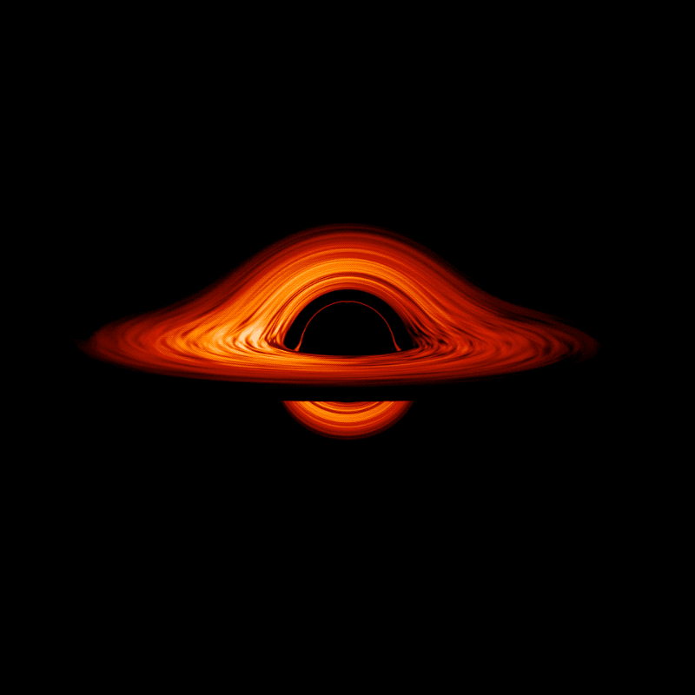
What is a black hole?
Huge concentration of matter packed into a very tiny space, called singularity.
A black hole is so dense that the gravitation pull just beneath its surface, the event horizon, is so strong that nothing, not even light, can escape.
Accretion Disk
Some black holes are surrounded by hot, swirling matter progressively falling inward towards the event horizon.
OBLIVION – Artistic Installation
1

Slide 3
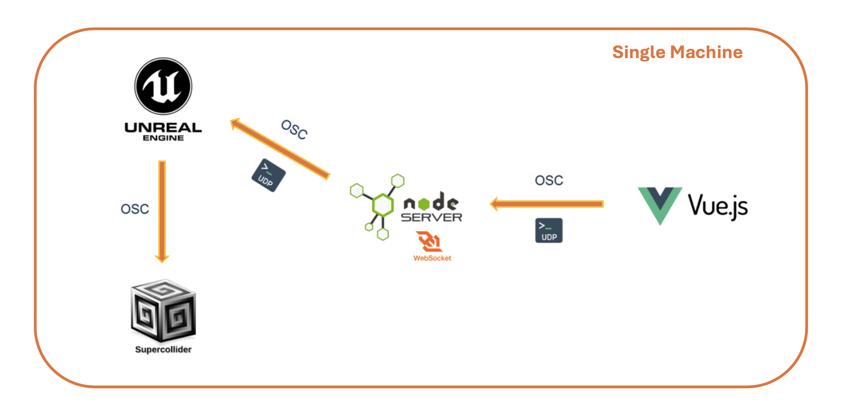
Architecture
Single Machine
OBLIVION – Artistic Installation
2

Slide 4
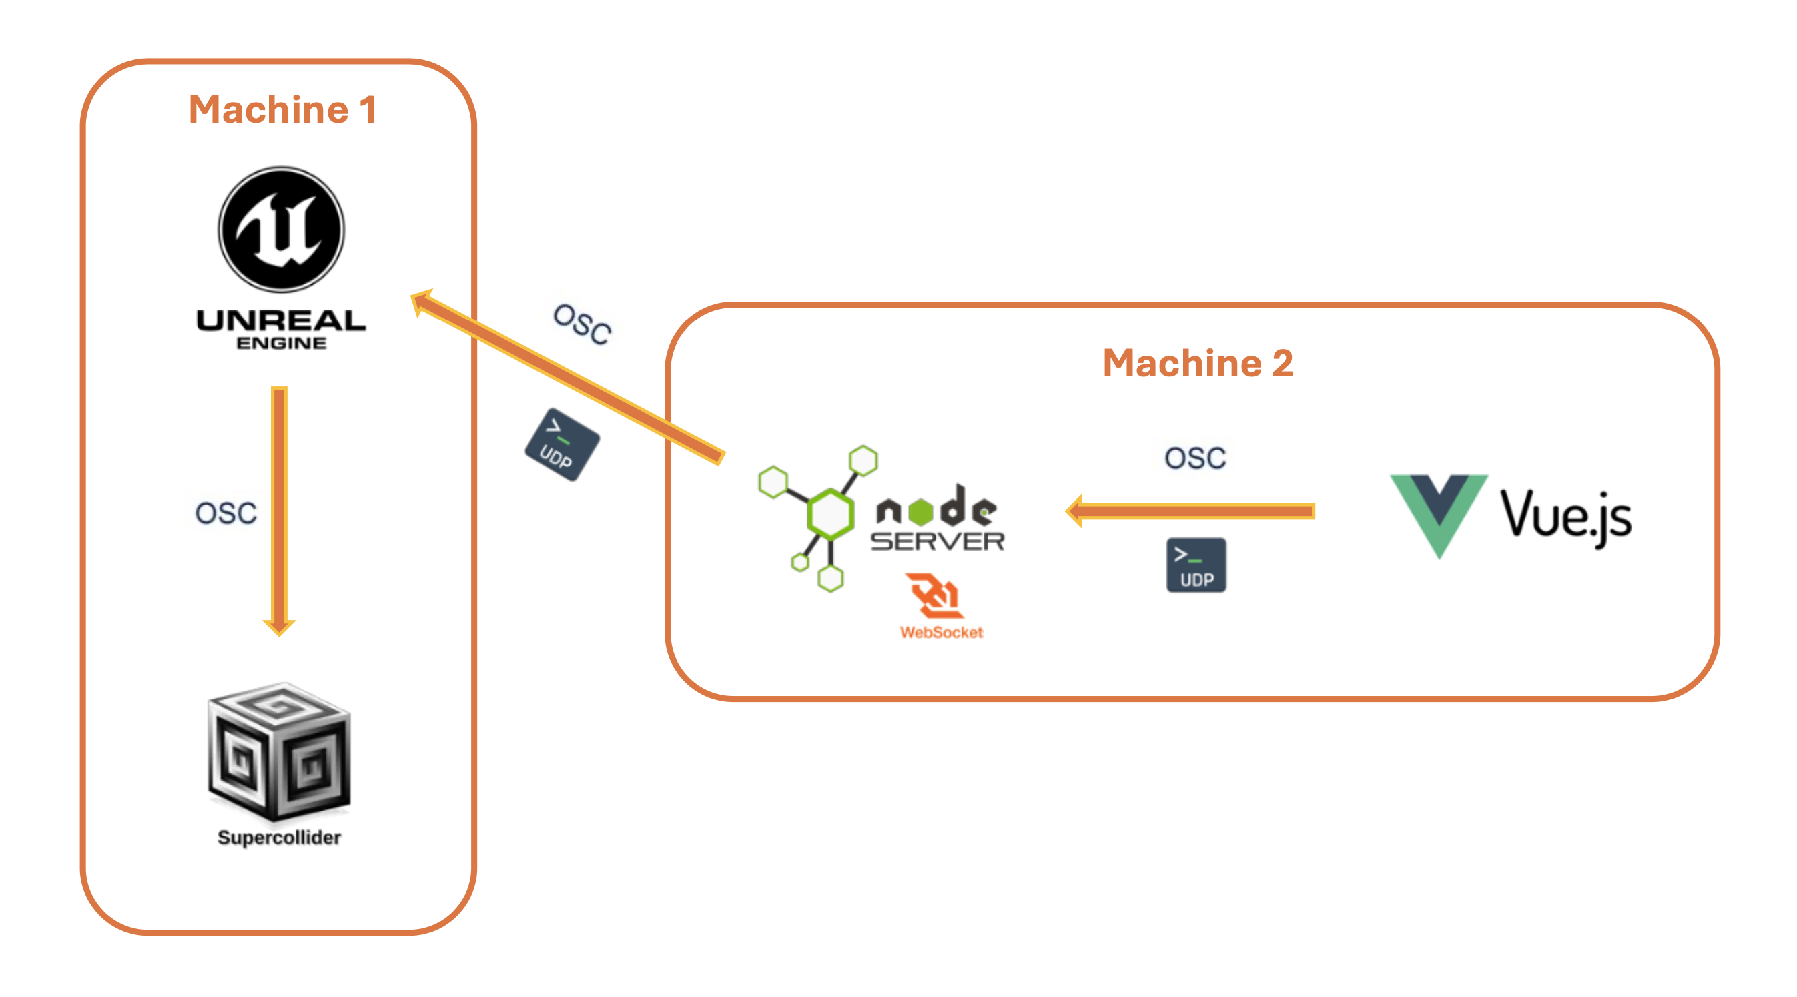
Architecture
Separate Machines
OBLIVION – Artistic Installation
3

Slide 5
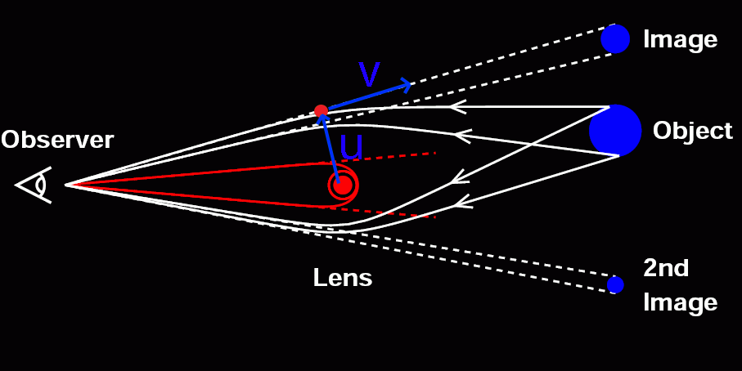
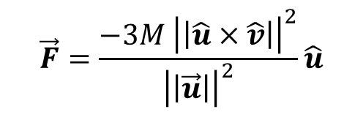
Black Hole Rendering
Implemented as a custom shader inside Unreal Engine
Ray Marching technique
Scene inside a sphere covered by sky space texture
Gravitational Lensing – simplified model
OBLIVION – Artistic Installation
4

Slide 6
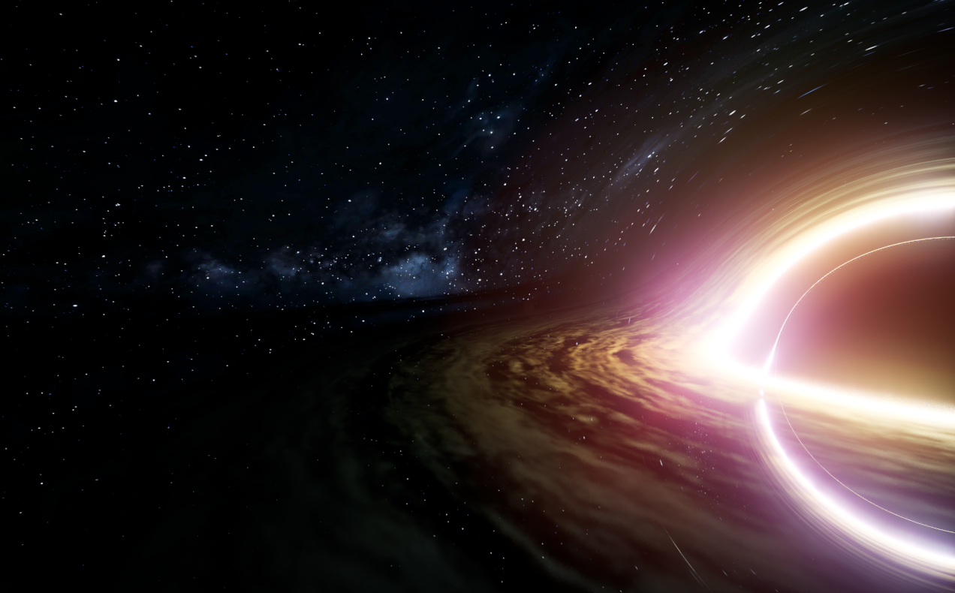
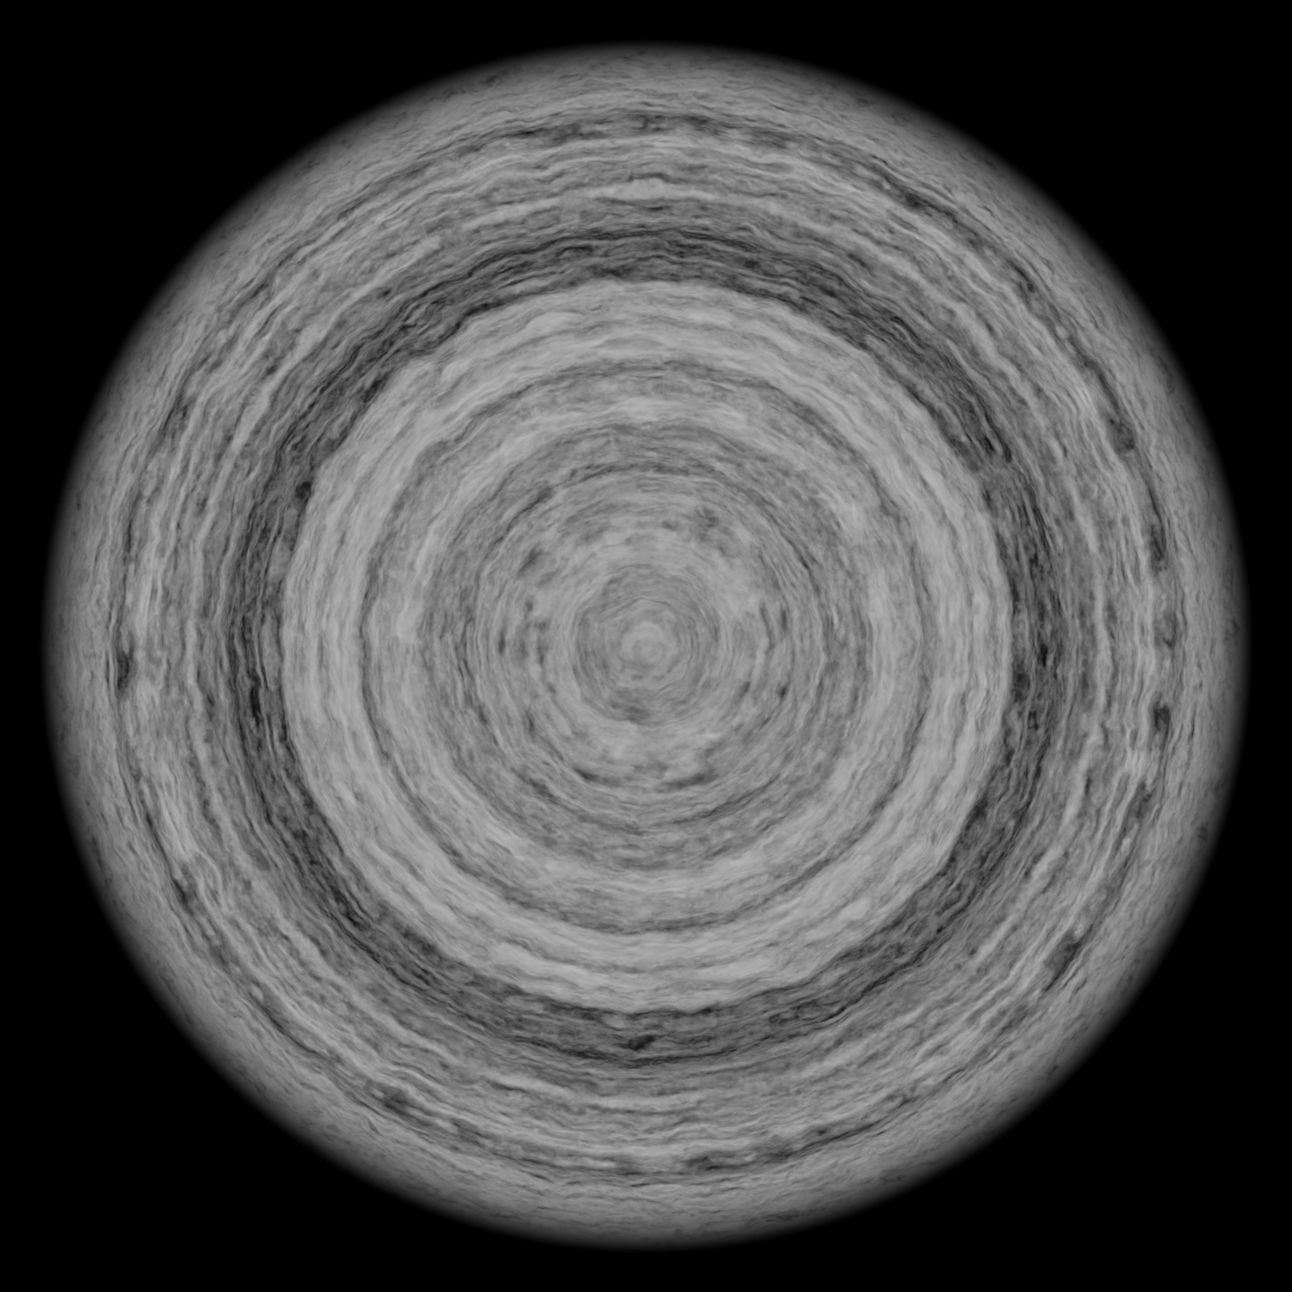
Black Hole Rendering
Accretion Disk – Rendering Process
Check intersection with disk region
Compute density using pre-defined texture
Compute light intensity using square roll-off
Compute shadow (light absorption) using volumetric ray-marching
Sum contribution of disk and fog layer
Disk texture
OBLIVION – Artistic Installation
5

Slide 7


Black Hole Rendering
Accretion Disk - Color
Color is determined using a black body radiation map
Sample according to temperature and frequency shift
Temperature decreases with distance
Frequency shift due to motion (doppler effect)
Blueshift
Blackbody radiation
map
OBLIVION – Artistic Installation
6

Slide 8
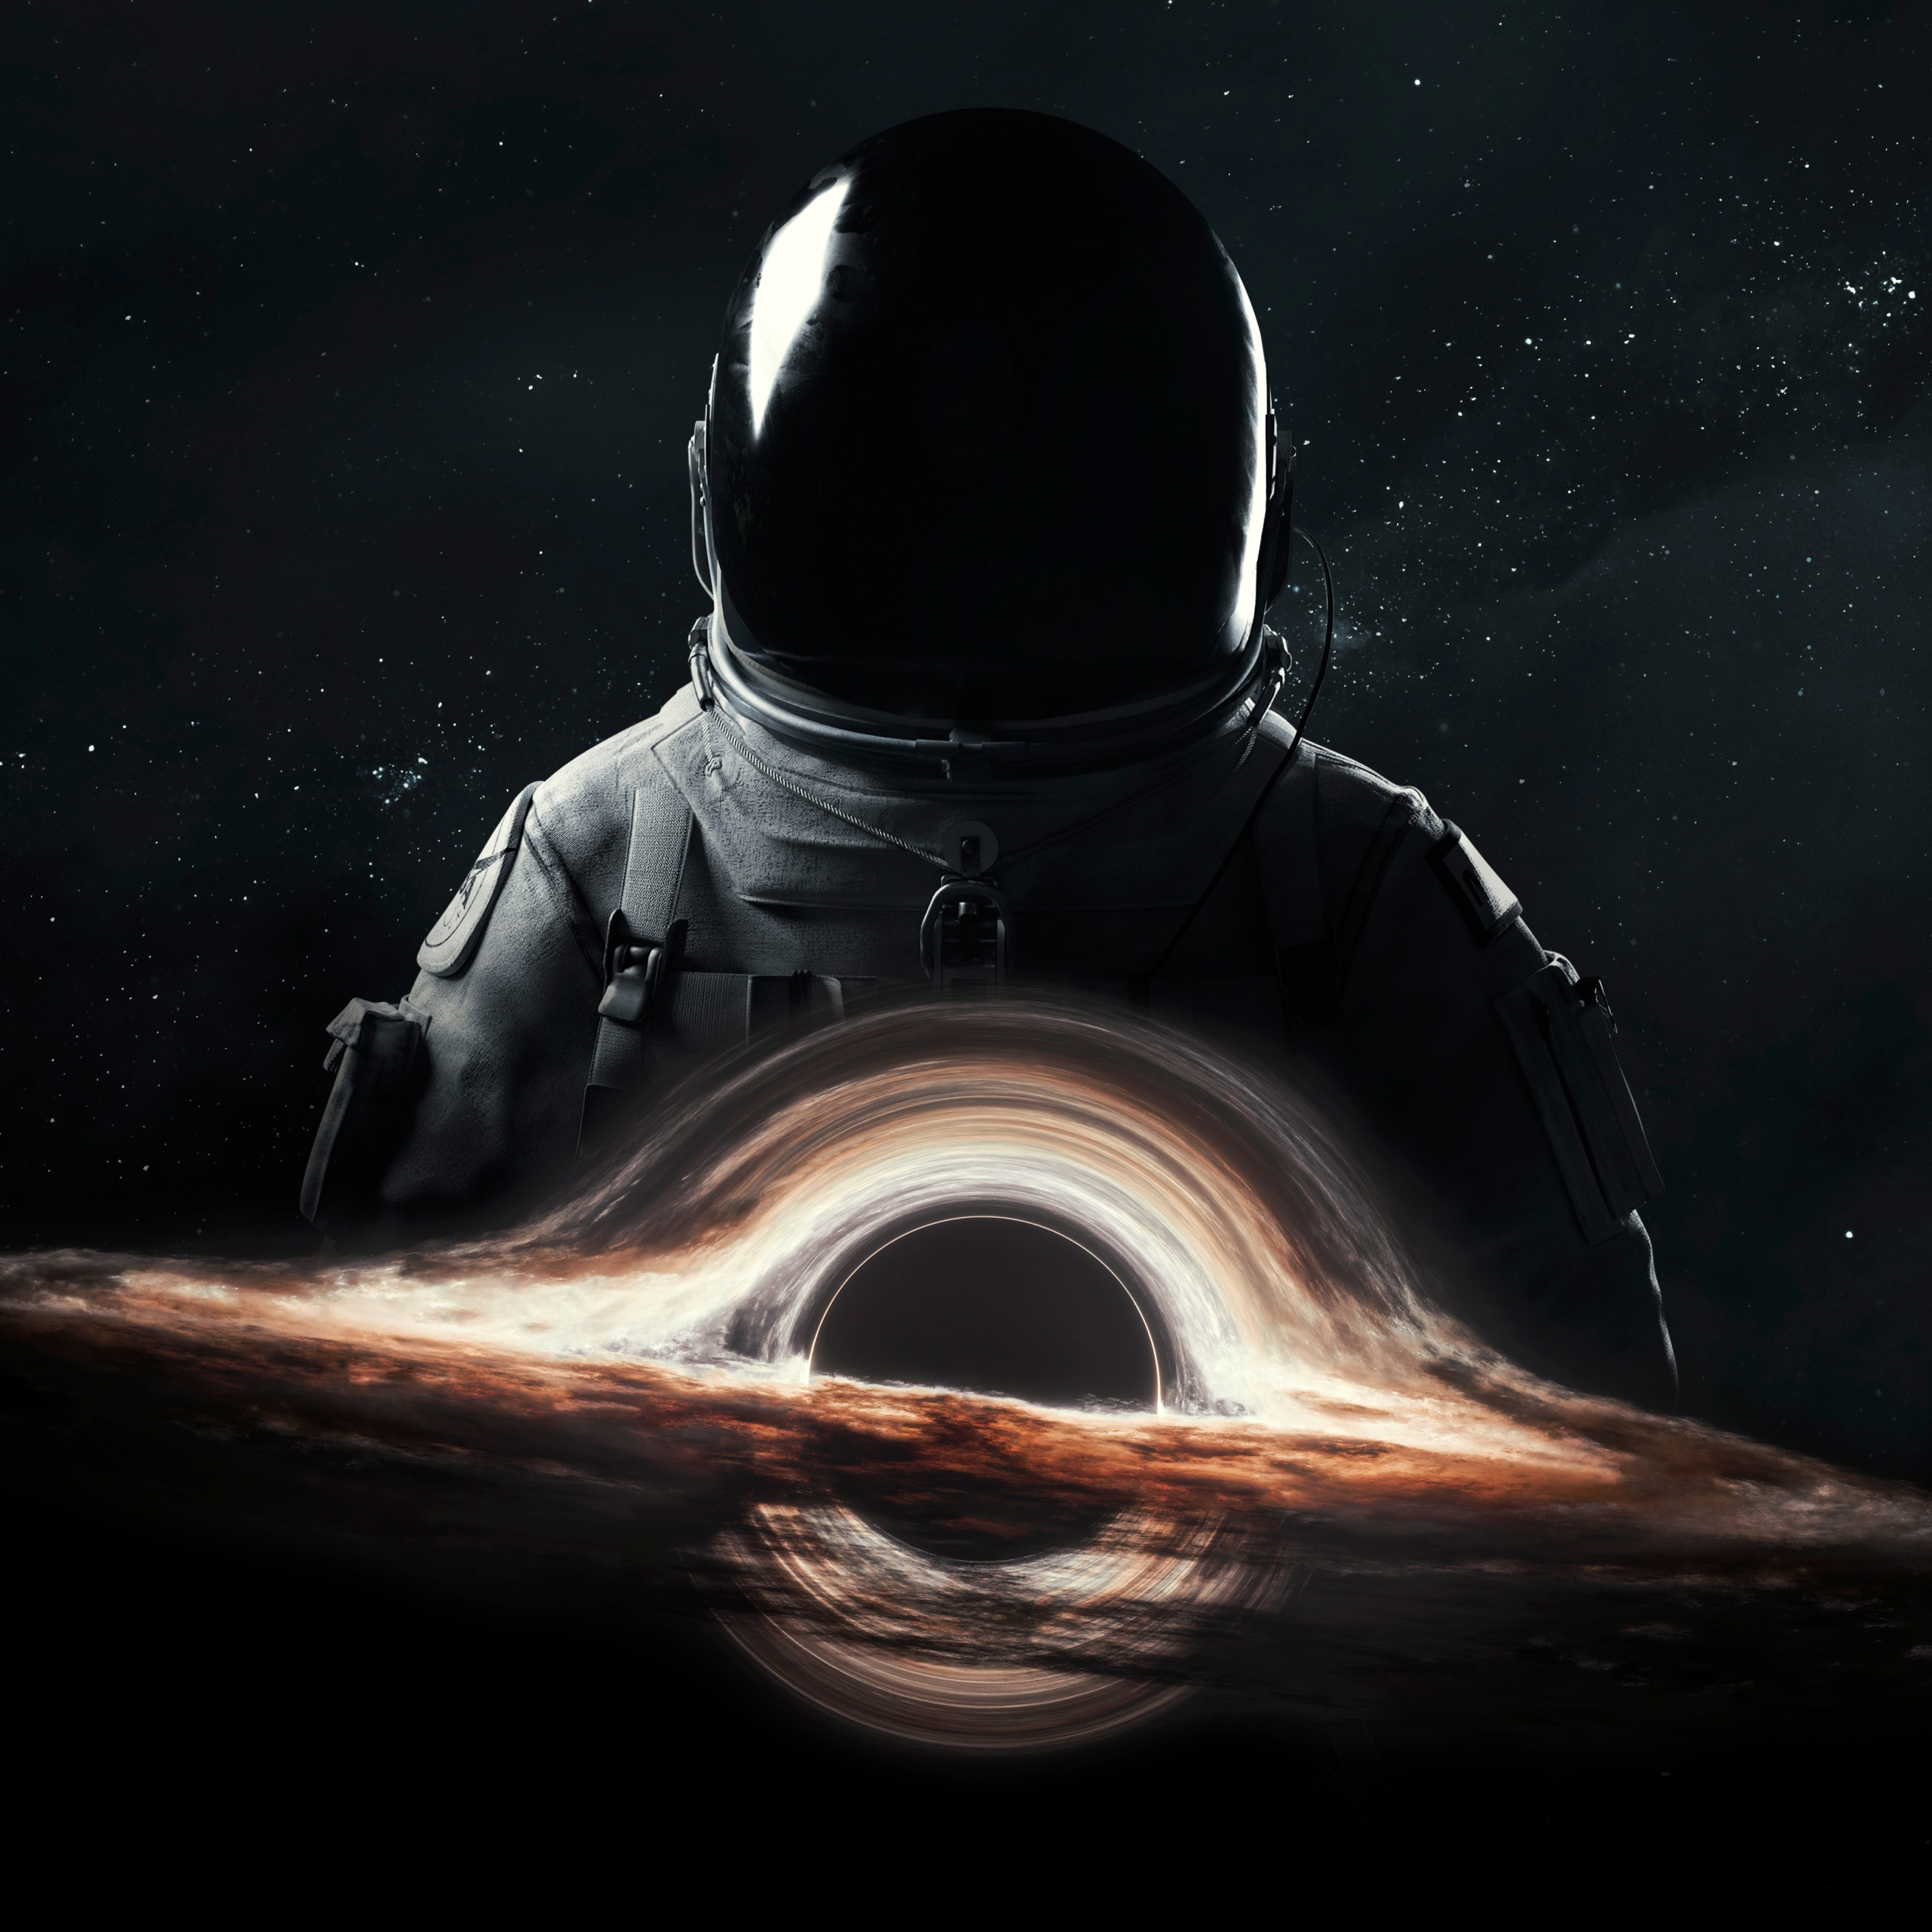
Generative Music
Everything implemented using SuperCollider. The OSC communication protocol makes it communicating with Unreal Engine.
The main goal is to emulate sci-fi music in a generative fashion while maintaining a certain grade of control on the algorithm.
The aim of this algorithm is to enlighten the vastity of the universe and the immense power of a black hole.
OBLIVION – Artistic Installation
7

Slide 9

Generative Music
Different kind of synthesis:
Subtractive (main background)
FM (modulated FX and “particle noise”)
Wavetable (Ringing sounds)
Digital Waveguide (“gusts of wind”)
All the synths are processed by a reverb effect which also provides companding and limiting functionalities.
OBLIVION – Artistic Installation
8

Slide 10
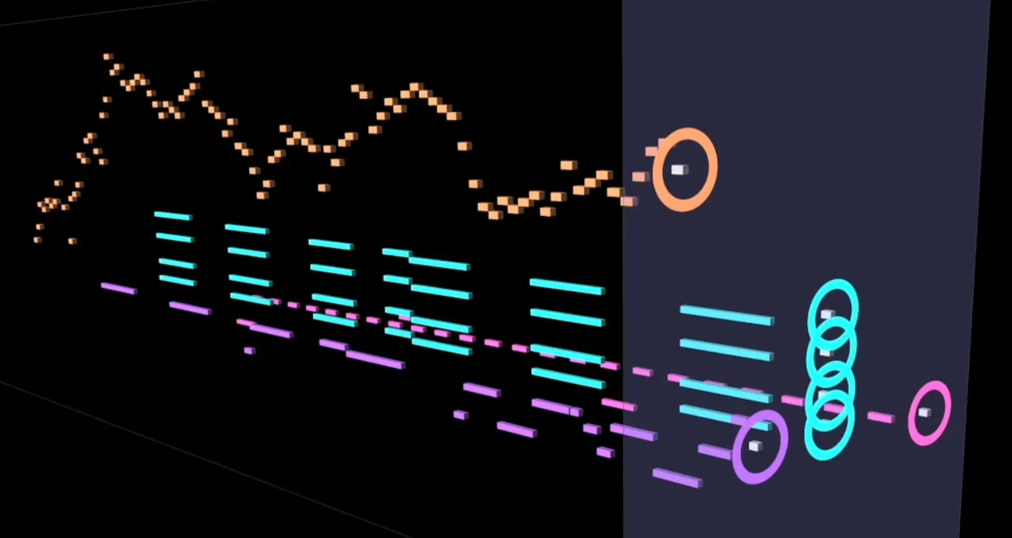
Generative Music
Fundamental frequencies are picked up from a more restricted set of values while all the other parameters are randomly generated within a pre-established range. All the sounds are generated regularly in time with a minimum grade of randomness.
Parameters from the physical simulation influence the soundscape:
Mass: low frequencies amplitude
Temperature: "particle noise“ amplitude
Disk Size: mid frequencies amplitude
Rotation Speed: high frequencies amplitude
Distance: FXs amplitude and rate of occurrence
OBLIVION – Artistic Installation
9

Slide 11
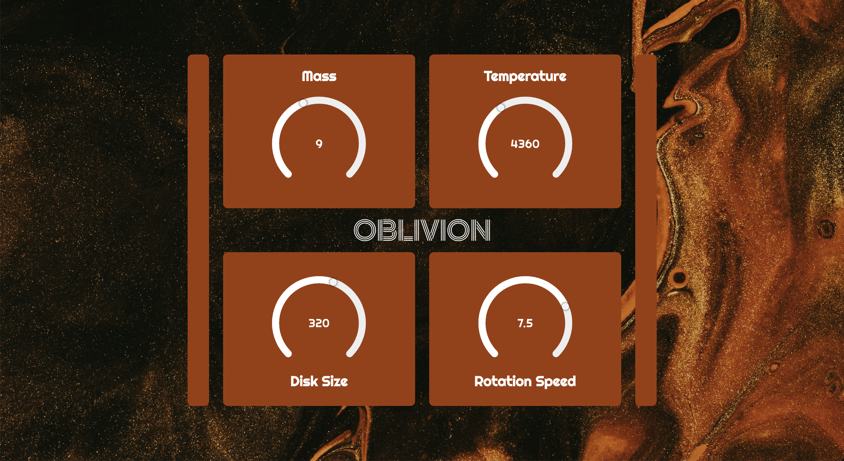
Web Application
Vue App
OBLIVION – Artistic Installation
10

Slide 12
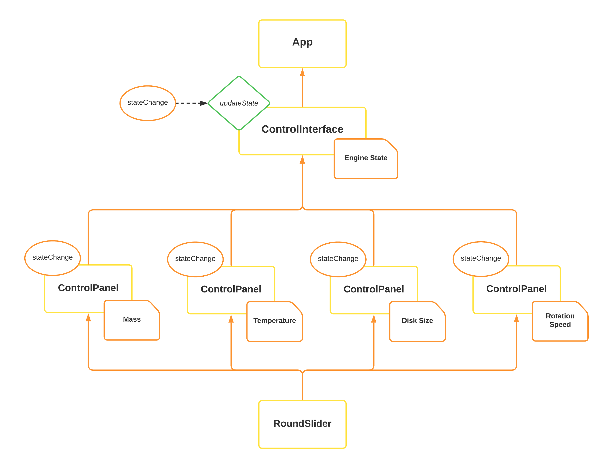
Web App Architecture
OBLIVION – Artistic Installation
11

Slide 13
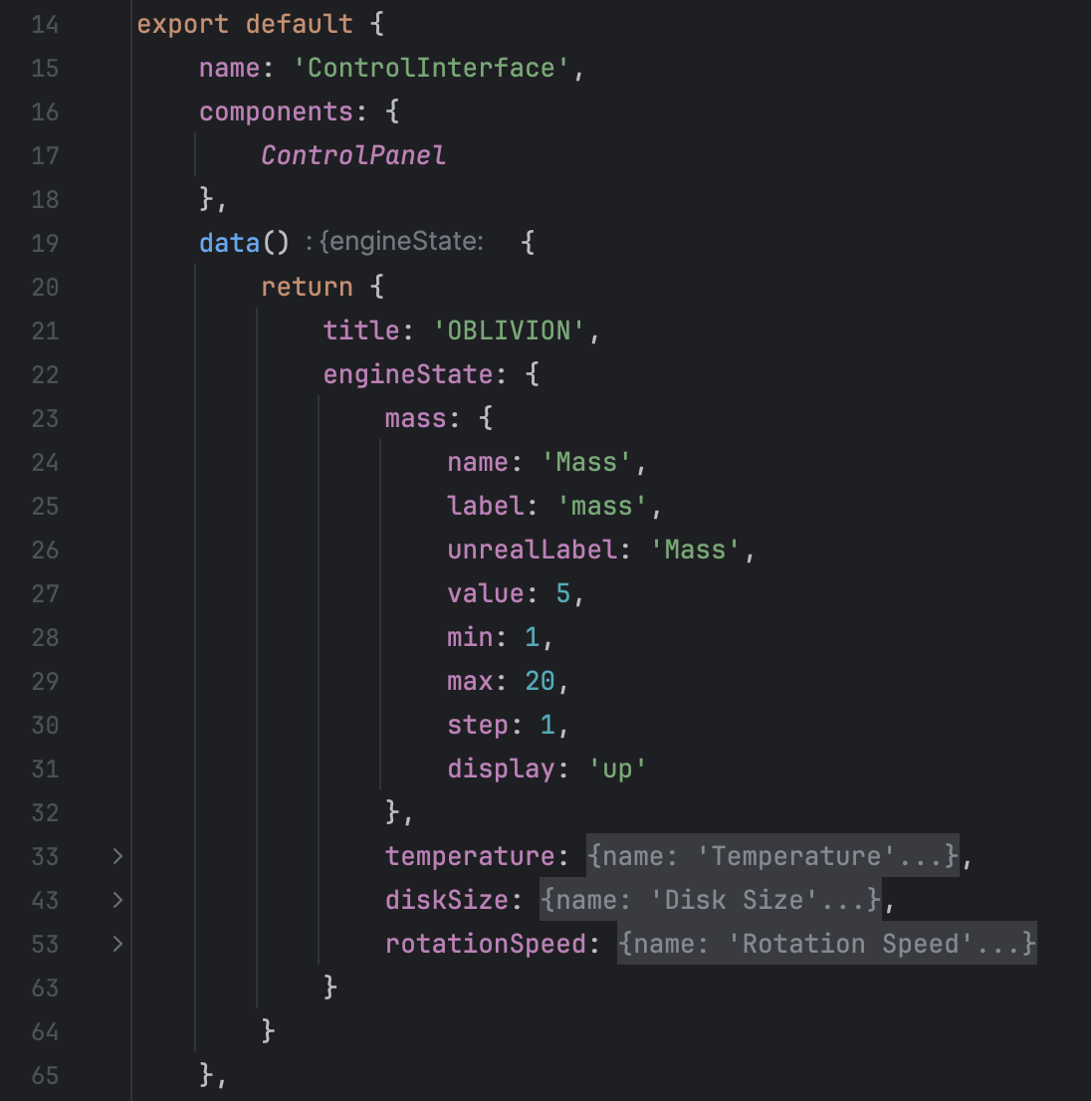
Engine State
The global state of available parameters is defined as an object, named engineState, in the ControlInterface component within its data function.
This object holds on its turn multiple objects, one for each parameter control displayed within the GUI.
Each one of these objects is passed as a property to the corresponding ControlPanel instance (child component) for initialization of its round slider.
OBLIVION – Artistic Installation
12

Slide 14
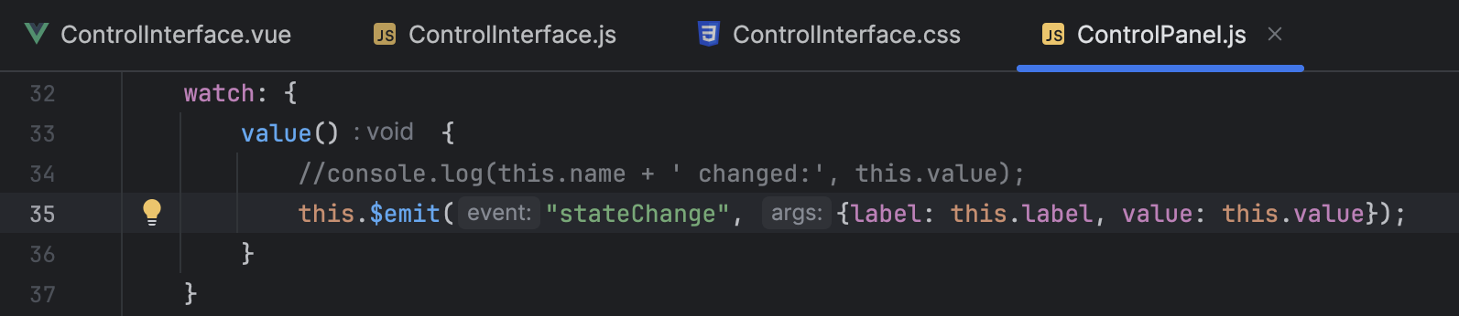
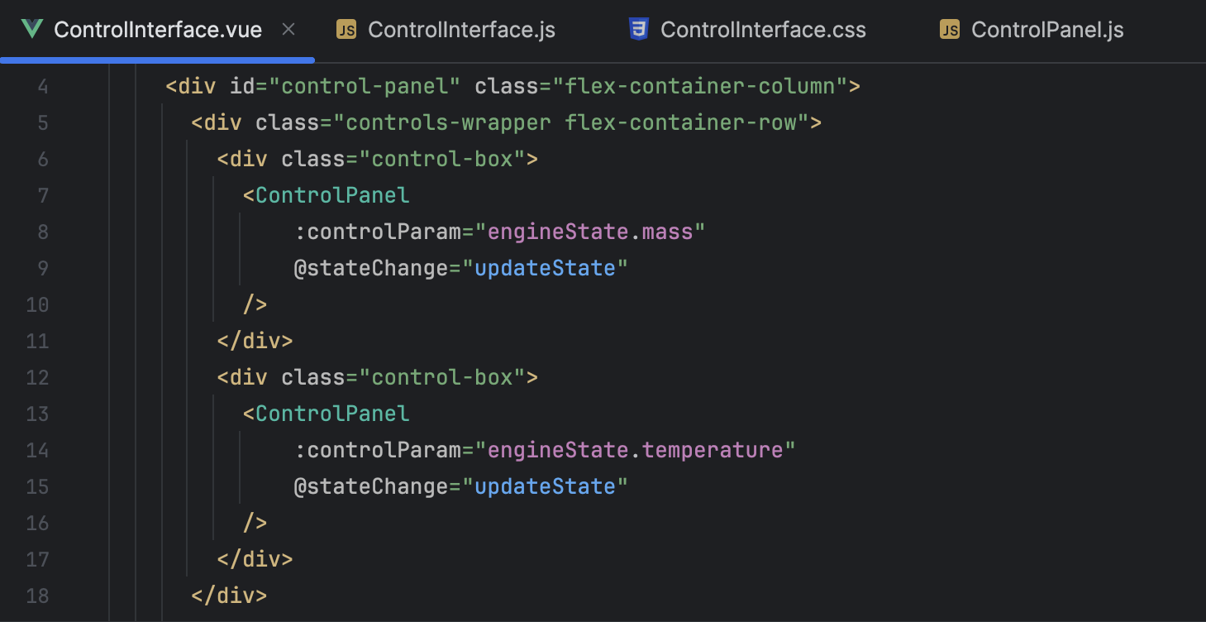
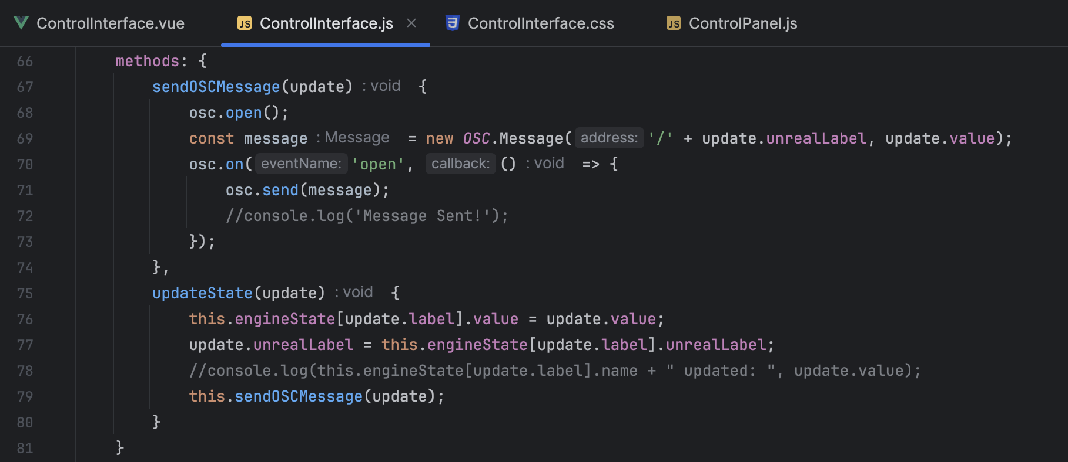
Engine State Update
A Vue Watcher is employed for each instance to emit stateChange custom event that is dispatched to the parent whenever the user modifies the single parameter value.
v-model directive automatically updates the internal state of the single ControlPanel component.
OBLIVION – Artistic Installation
13

Slide 15

OSC Communication over UDP
The OSC Communication between the Web App and Unreal Engine was implemented through a Node WebSocket Server listening to OSC Messages coming from an OSC WebSocket Client running within the Vue App.
OSC Messages are then broadcasted over UDP to the receiver, which could run on the same machine or on a remote one.
OBLIVION – Artistic Installation
14

Slide 16
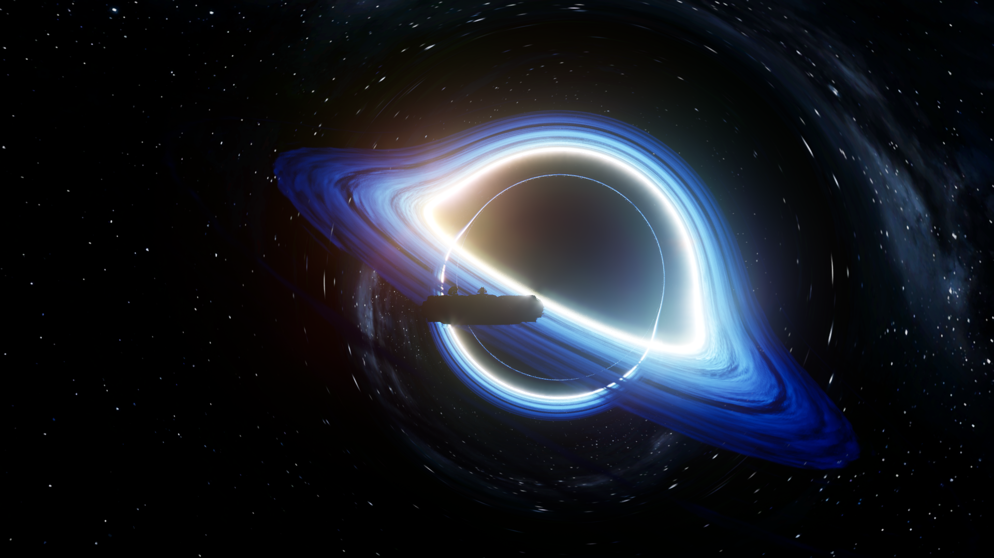
Let’s jump into Space!

Slide 17
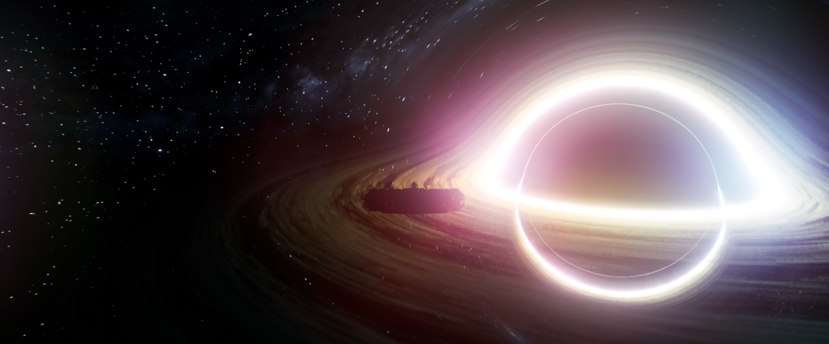

OBLIVION
Creative Installation
Interactive Black Hole Visualization and
Artistic Sonorization
Group Members
Riccardo Di Bella
THANK YOU!
Marco Muraro
Stefano Ravasi

